Slide 1
WannaCry Analysis & YARA Detection
Alexander Waldenmaier, David Mberingabo, Kee Hock Tan, William Flanagan

Slide 2
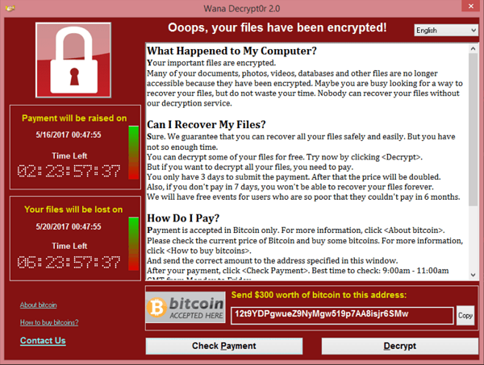
Agenda
Introduction to WannaCry
Dynamic Analysis
Static Analysis
Application of YARA
Conclusion

Slide 3
Introduction to WannaCry Overview
Worm+Ransomware attack allegedly perpetrated by North Korean “Lazarus Group”
Began at 07:44 UTC on 12 Feb 2017, stopped several hours later after discovery of a killswitch domain
Initial attack likely affected several hundred thousand machines worldwide, more waves followed until 2018
Enabled by two exploits discovered by NSA prior to attack: Eternal Blue and Double Pulsar

Slide 4
Introduction to WannaCry Prelude: EternalBlue and DoublePulsar
EternalBlue:
Allows for RCE
RAM-resident
Based on three bugs in the SMB protocol
Patched by Microsoft 1 month prior to attack
DoublePulsar:
Payload transmitted using EternalBlue
Permanent backdoor (ping, kill, exec)
Allows for kernel-level shellcode execution

Slide 5

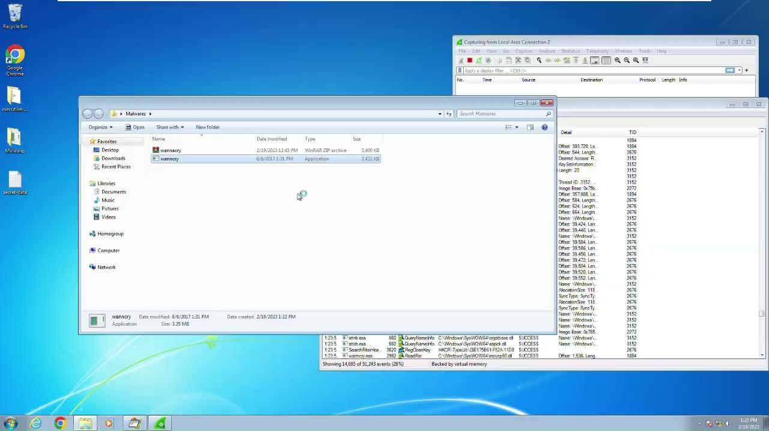

Dynamic Analysis Malware Detonation
Windows 7 VM
No Antivirus installed and Windows Firewall Disabled
ProMon, WireShark, RegShot running
Ubuntu VM
inetsim configured - DNS returns Ubuntu’s IP address
https://drive.google.com/file/d/17W1_h1Pv9MmRPG1GYu4NPn2pVpr4OTks/view?usp=sharing

Slide 6
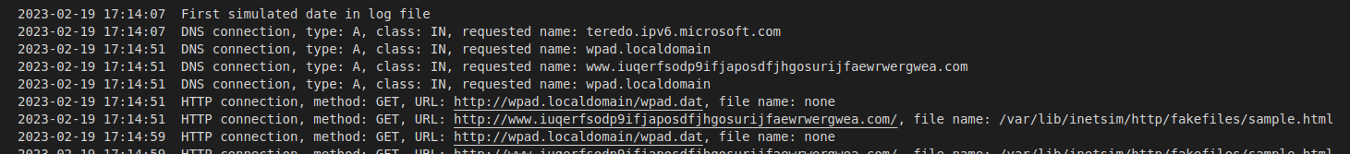
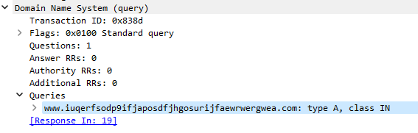
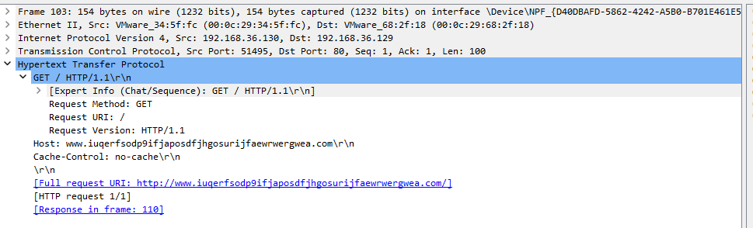
Dynamic Analysis Key Malware Activities
DNS and HTTP Requests to www.iuqerfsodp9ifjaposdfjhgosurijfaewrwergwea.com

Slide 7
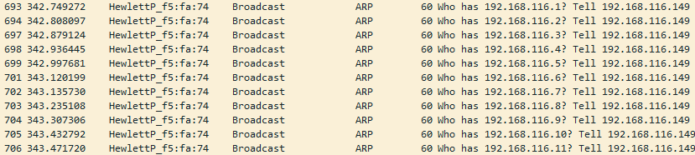
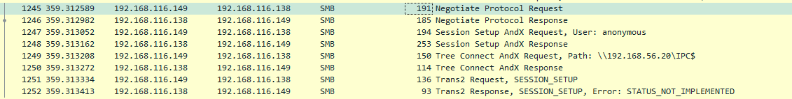
Dynamic Analysis Key Malware Activities
Incrementally increases the IP addresses
Verifying the vulnerability in SMBv1
Attempts to discover the network and perform SMB related operations
Notes:
Reference: https://people-ece.vse.gmu.edu/coursewebpages/ECE/ECE646/F20/project/F18_presentations/Session_III/Session_III_Report_3.pdf

Slide 8
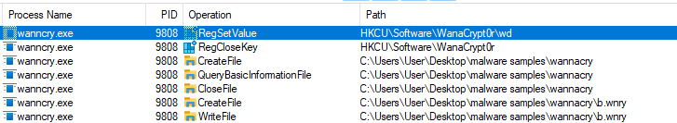
Dynamic Analysis Key Malware Activities
It will attempt to first create its meta-files (eg. messages in different language) and decryption program (popup)
Encryption of files (selected file extensions)
File System Manipulation - Creating WannaCry related files and R/W operations for encryption

Slide 9
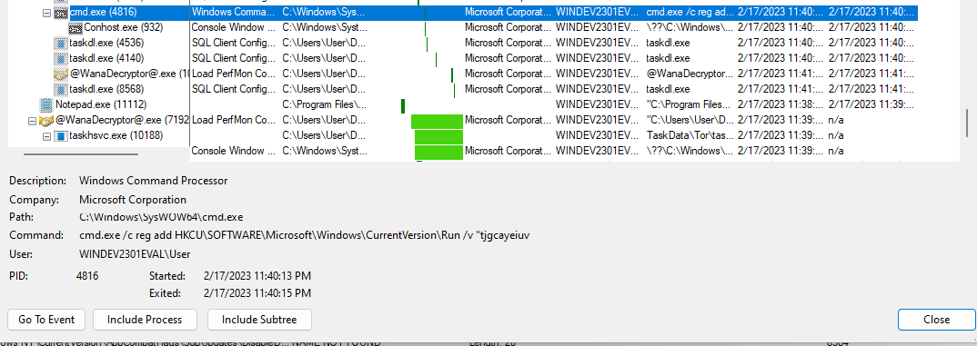
Dynamic Analysis Key Malware Activities
Registry Manipulation - Ensuring Persistence
cmd.exe /c reg add HKCU\SOFTWARE\Microsoft\Windows\CurrentVersion\Run /v "tjgcayeiuvirqe377" /t REG_SZ /d "\"C:\Users\User\Desktop\malware samples\wannacry\tasksche.exe\"" /f

Slide 10
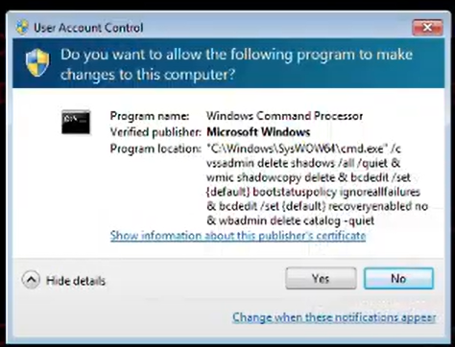
Dynamic Analysis Key Malware Activities
Volume Shadow Copy Service (VSS):
Windows’ backup service that allows you to create shadow copies (snapshot / point-in-time backups)
Ransomware commonly use VSS related utilities to delete backups to prevent system restoration
Deleting shadow copies using vssadmin and wmic
Notes:
Reference
https://blogs.vmware.com/security/2022/09/threat-report-illuminating-volume-shadow-deletion.html
https://learn.microsoft.com/en-us/windows-server/storage/file-server/volume-shadow-copy-service

Slide 11
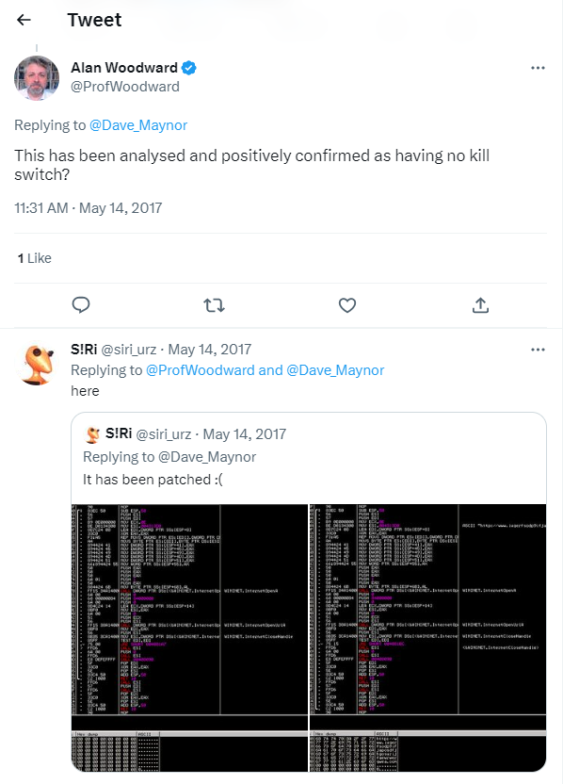
Other Interesting Observations about WannaCry
Performs the encryption (on selected file extensions) once and will not encrypt newer files
Newer variants do not have a killswitch
Extensive support in various languages
The developers planned for it to be global!
Known to have very good customer service
Notes:
https://twitter.com/ProfWoodward/status/863778728475848705

Slide 12
Static Analysis
Dissecting WannaCry
We will focus on the main function and common artefacts that we can find

Slide 13
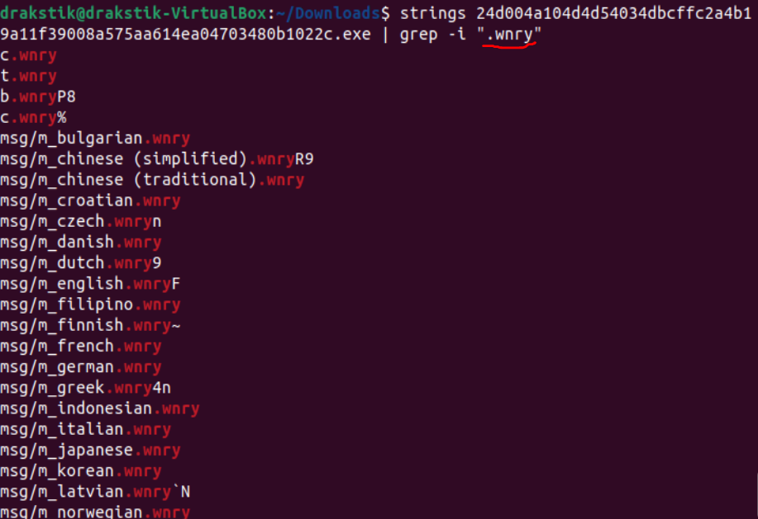
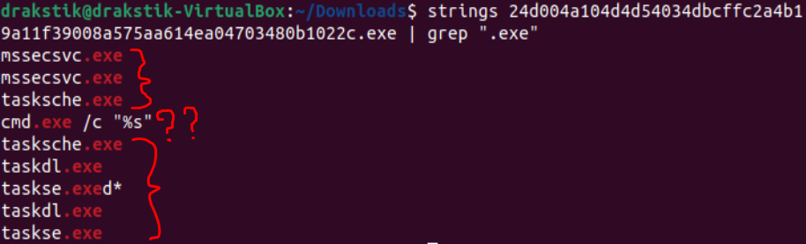
t|u|b|c|msg/*.wnry: Encrypted Tools & configs, Ransom Messages and Images.
cmd.exe: Command prompt shell!
mssecsvc.exe: Spoofed core component of Windows Defender. (Persistence + Worm)
taskse.exe: Unique dropper tool
taskdl.exe: removes temporary files
%s\IPC: Used by SMB Tree Connect AndX Request to recursively verify SMBv1 vulnerabilities in the local network.
“WANNACRY”
Strings Artifacts
Main function
Notes:
The wnry files are encrypted tools and ransom messages, which can be identified once detonated.
We enumerate executables embedded in the malware executable, and find:
A command shell, which is not suspicious on its own, but can be an indicator if combined with other findings
Mssecsvc.exe is a real core Windows security component that is spoofed and installed by the malware for persistence and spreading to other computers
Tasks.exe is a unique dropper tool
taskdl.exe: removes temporary files. The 3 files in read are unique to this variant of Wannacry
IPC keyword is used by SMB Tree Connect AndX Request to verify SMBv1 vulnerabilities
And finally, different spellings and misspellings of “WANNACRY” were found littered around.

Slide 14
Killswitch Domain
Check if random domain is registered, and do not detonate ransomware if the domain is registered.

Slide 15
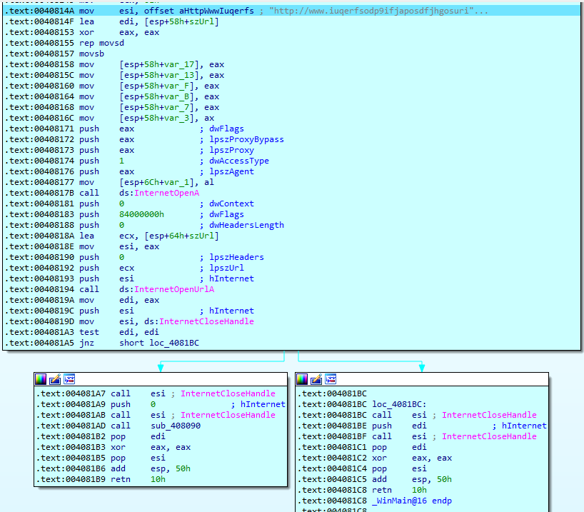
Killswitch Function Flow
1. Create string of killswitch domain and initialize some variables with value 0x00
Zero Flag (ZF) = 0
Zero Flag (ZF) = 1
Main function
Notes:
This wannacry variant has a killswitch that is checked before actually launching the attack.
It checks if a random IP has been registered, and if it has not been registered, then the attack is not launched.
So let’s walk through the killswitch part of the binary executable reconstructed into assembly

Slide 16
Killswitch Function Flow
dwAccessType set to 1 uses default proxy configs
1. Create string of killswitch domain and initialize some variables with value 0x00
2. “InternetOpenA” Windows API C function call with arguments [dwFlags, lpszProxyBypass, lpszProxy, dwAccessType, lpszAgent].
Zero Flag (ZF) = 0
Zero Flag (ZF) = 1
Main function
Notes:
InternetOpenA function (wininet.h) - Initializes an application's use of the WinINet functions.

Slide 17
Killswitch Function Flow
1. Create string of killswitch domain and initialize some variables with value 0x00
2. “InternetOpenA” Windows API C function call with arguments [dwFlags, lpszProxyBypass, lpszProxy, dwAccessType, lpszAgent].
3. “InternetOpenUrlA” function call with arguments [dwContext, dwFkags, dwHeadersLength, lpszHeaders, lpszUrl and hInternet].
Zero Flag (ZF) = 0
Zero Flag (ZF) = 1
Main function
Notes:
InternetOpenA function (wininet.h) - Initializes an application's use of the WinINet functions.
InternetOpenUrlA function (wininet.h) - Opens a resource specified by a complete FTP or HTTP URL.

Slide 18
Killswitch Function Flow
4. “InternetCloseHandle” function is stored with argument: hInternet, to be used later.
Zero Flag (ZF) = 0
Zero Flag (ZF) = 1
Main function
Notes:
InternetOpenA function (wininet.h) - Initializes an application's use of the WinINet functions.
InternetOpenUrlA function (wininet.h) - Opens a resource specified by a complete FTP or HTTP URL.

Slide 19
Killswitch Function Flow
4. “InternetCloseHandle” function is stored with argument: hInternet, to be used later.
5. Test if “InternetOpenUrlA“ returned valid handle (ZF = 1) or null pointer (ZF = 0).
Zero Flag (ZF) = 0
Zero Flag (ZF) = 1
Main function
Notes:
InternetOpenA function (wininet.h) - Initializes an application's use of the WinINet functions.
InternetOpenUrlA function (wininet.h) - Opens a resource specified by a complete FTP or HTTP URL.

Slide 20
Killswitch Function Flow
4. “InternetCloseHandle” function is stored with argument: hInternet, to be used later.
5. Test if “InternetOpenUrlA“ returned valid handle (ZF = 1) or null pointer (ZF = 0).
6a. If Zero Flag = 0, then close internet handle and call a subroutine. THIS IS WHERE THE ENCRYPTION STARTS!
Zero Flag (ZF) = 0
Zero Flag (ZF) = 1
Main function
Notes:
InternetOpenA function (wininet.h) - Initializes an application's use of the WinINet functions.
InternetCloseHandle - closes internet connection
InternetOpenUrlA function (wininet.h) - Opens a resource specified by a complete FTP or HTTP URL.

Slide 21
Killswitch Function Flow
4. “InternetCloseHandle” function is stored with argument: hInternet, to be used later.
5. Test if “InternetOpenUrlA“ returned valid handle (ZF = 1) or null pointer (ZF = 0).
6a. If Zero Flag = 0, then close internet handle and call a subroutine. THIS IS WHERE THE ENCRYPTION STARTS!
6b. If Zero Flag = 1, then close internet handle and exits. KILLSWITCH ACTIVATED!
Zero Flag (ZF) = 0
Zero Flag (ZF) = 1
Main function
Notes:
InternetOpenA function (wininet.h) - Initializes an application's use of the WinINet functions.
InternetOpenUrlA function (wininet.h) - Opens a resource specified by a complete FTP or HTTP URL.

Slide 22
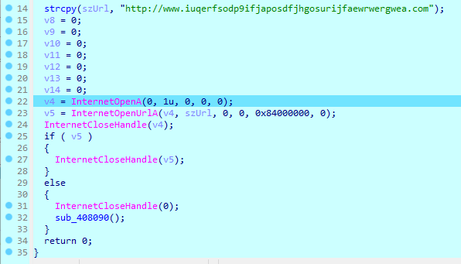
Killswitch Pseudocode Generated by IDA Pro
Main function

Slide 23
Application of Yara
Using our discovered IOCs to detect the malware

Slide 24
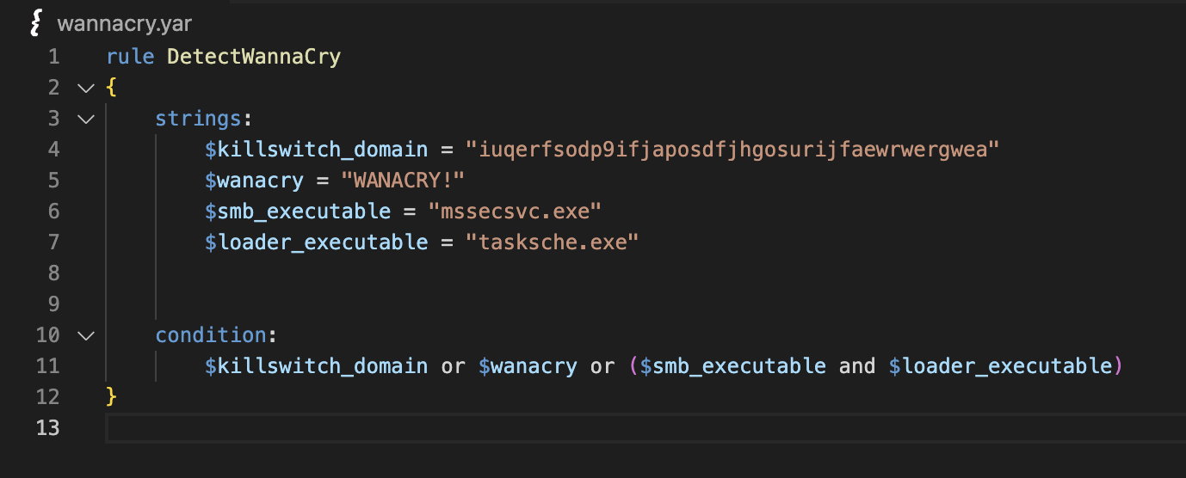
Application of YARA Deriving a simple YARA rule

Slide 25
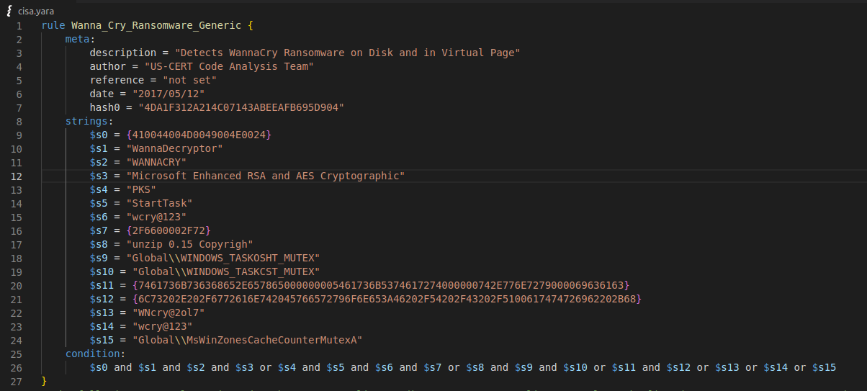
Application of YARA More complex YARA rules
Reference: https://www.cisa.gov/news-events/alerts/2017/05/12/indicators-associated-wannacry-ransomware

Slide 26
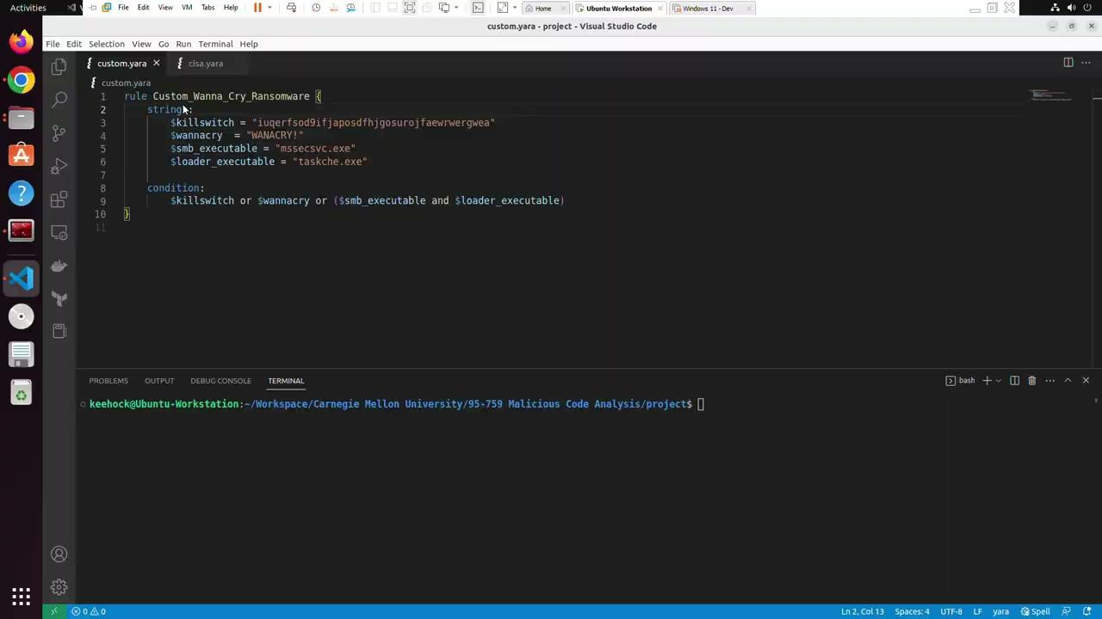
Application of YARA Watch it in action!
https://drive.google.com/file/d/1VkRhklZz9hF5gPZyOXhe__50Nk25I9A8/view?usp=sharing

Slide 27
Conclusion
Artefacts from dynamic and static analysis are fed to the controls
Defending against malware attacks requires a multi-pronged approach across layers (host-based defences, network defences, etc)
Well written YARA rules are generic enough to detect variants of original strains

Slide 28
Thank You
Any Questions?

